Slide 1
Access & Success in HE – the global picture
Dr. Graeme Atherton, Director, National Education Opportunities Network (NEON) UK

Slide 2
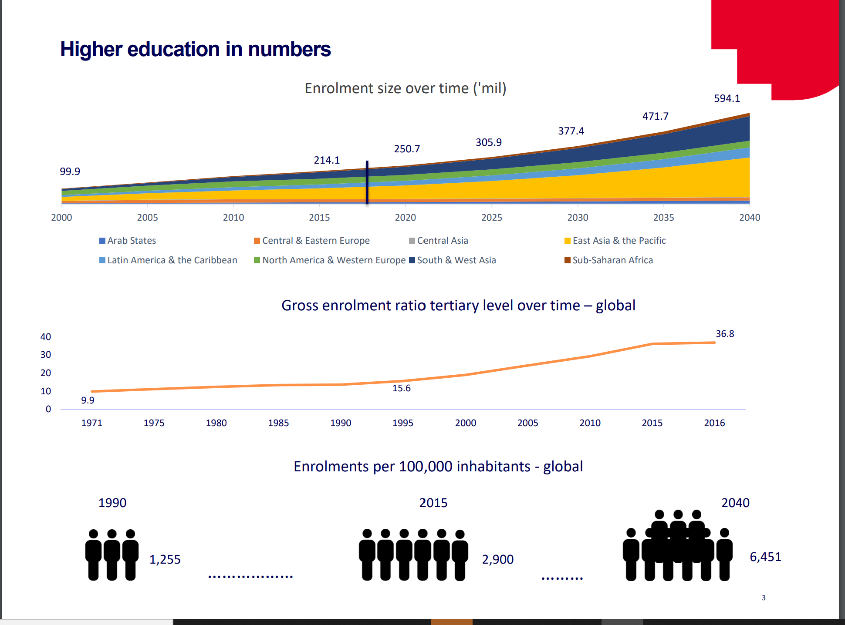

Slide 3
Inequality in HE access in over 90% of countries
Index Data
Gender Data
No Data
Other Data
Towards a Global Equity Data Charter?

Slide 4
Inequality in access to HE a global problem
‘Charting Equity: Drawing the Global Access Map’ (2016) – Atherton, Dumangane & Whitty
Major study of data available on access to HE across the world supported by Pearson Plc
https://www.pearson.com/content/dam/corporate/global/pearson-dot-com/files/innovation/Charting-Equity_WEB.pdf

Slide 5
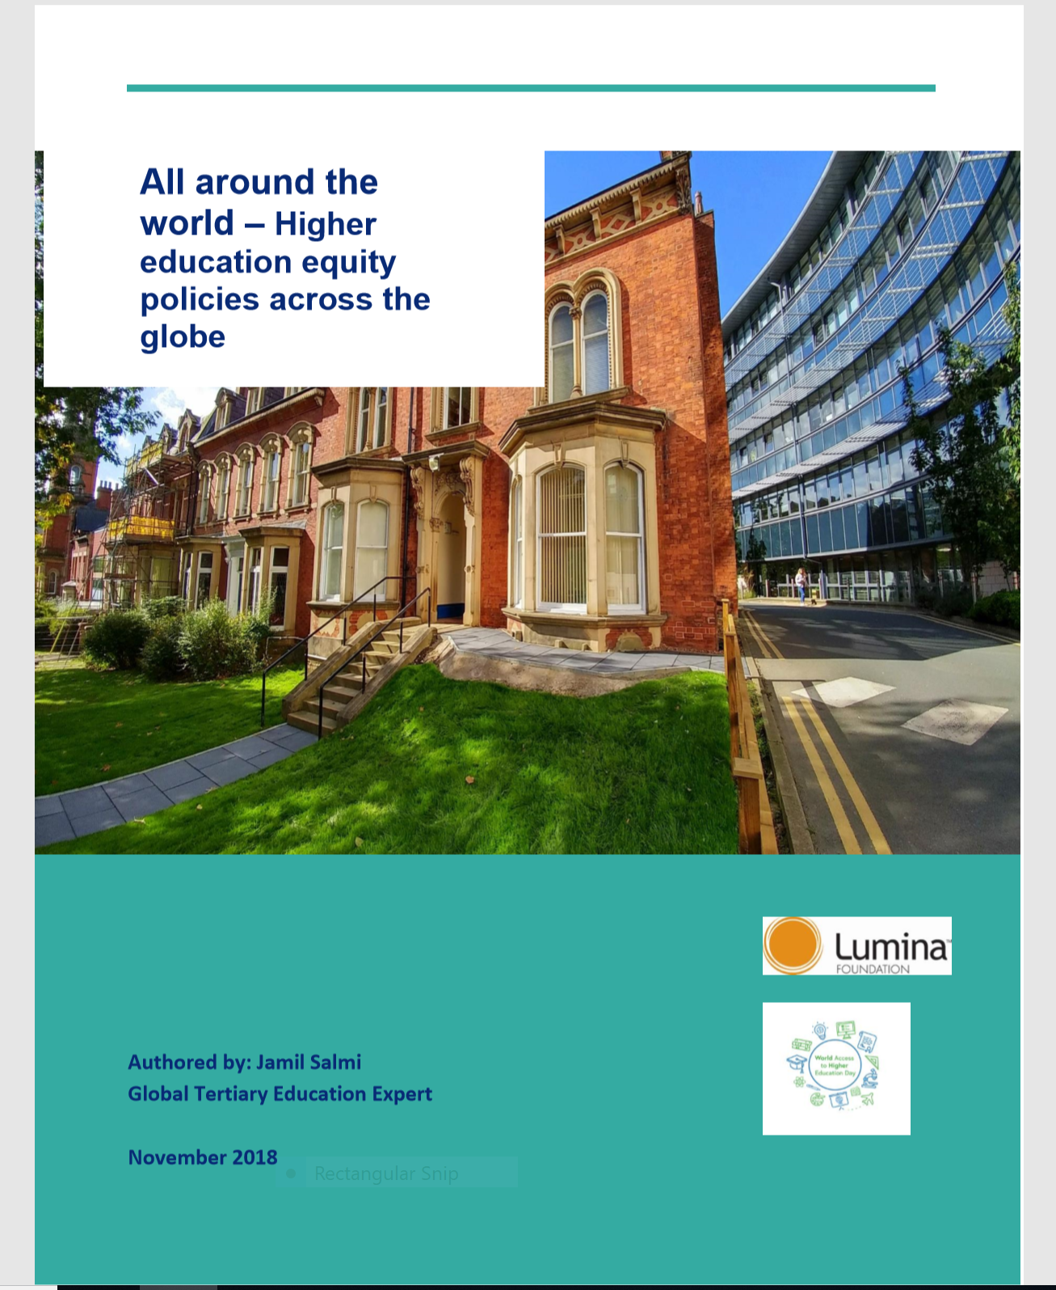

Slide 6
What did the study look at?
Aim: assess the nature and extent of policy commitments of national governments to address inequalities in access and success in higher education.
Also analyzes the equity promotion policies of relevant multilateral and regional agencies involved in providing policy advice, technical assistance and financial support.
Covered 71 countries - from across continents. Most from Latin America and Caribbean.

Slide 7
Key findings
Only 32% of the countries surveyed have defined specific participation targets for any equity group.
Only 11% of the countries surveyed have formulated a comprehensive equity strategy.
Another 11% have elaborated a specific policy document for one equity group, gender, people with disabilities, or members of indigenous groups.
Australia, Cuba, England, Ireland, New Zealand and Scotland have most developed national strategies

Slide 8
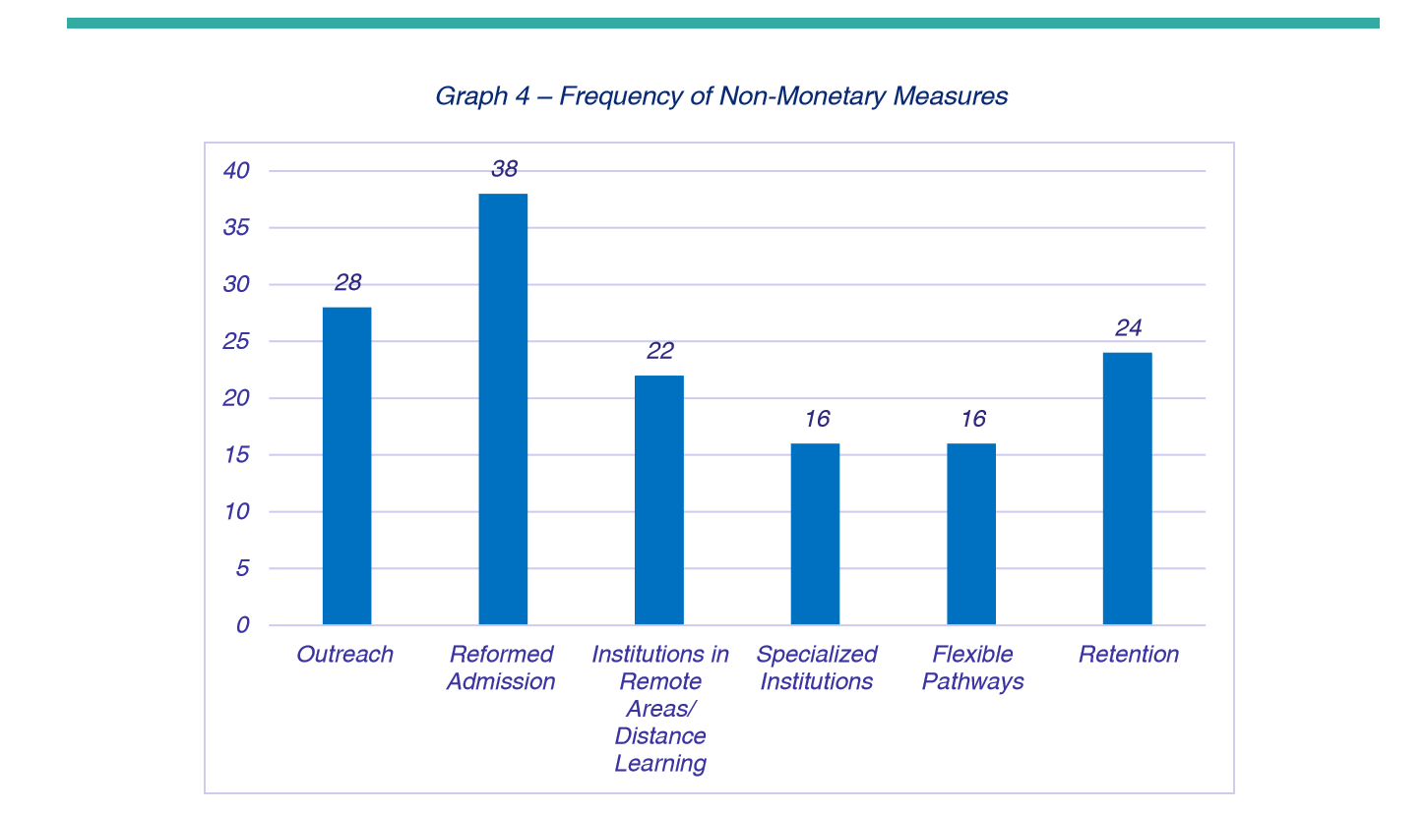

Slide 9
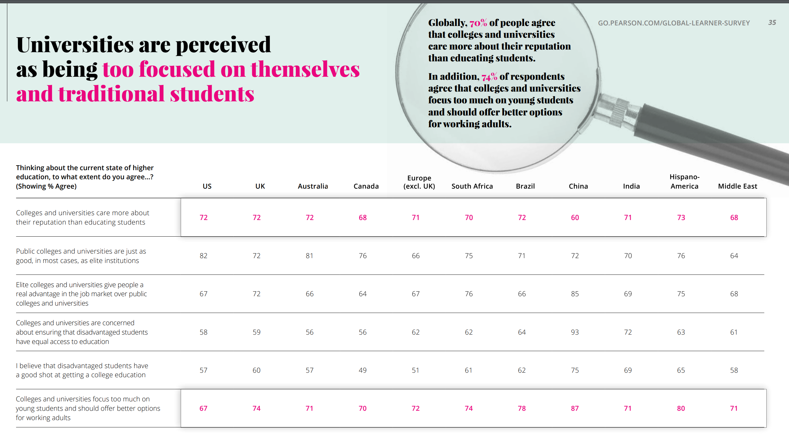

Slide 10
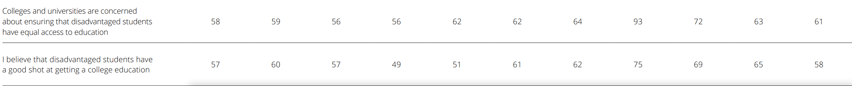

Slide 11

World Access to Higher Education Day (WAHED) 26th November 2019

Slide 12
What is WAHED?
Aim is to: act as a catalyst for global, regional and local action to address inequalities in access and success in higher education across the world.
A day where universities, students, NGOs, policymakers can focus on how to address inequalities in access/success through events, discussion and commitment.
Over 100 organisations from 30 countries participated in the first WAHED on the 28th November 2018.
Convened by the National Education Opportunities Network (NEON), the professional organisation for access to higher education in England.

Slide 13
WAHED 2019
New research looking at policy & impact in equitable access following up on ‘All around the World’ by Jamil Salmi funded by Lumina Foundation
1st WAHED Capacity Building course for 30 university managers from Asia/Europe in partnership with the Asia-Europe Foundation (ASEF)
WAHED Summit at the University of Edinburgh
Launch of premium supporter programme

Slide 14
Discussion questions
What are the major challenges in terms of inequalities in access and success in HE in your countries?
How can international collaboration help make universities and higher education more inclusive? And what could this collaboration look like?

Slide 15
To learn more about WAHED and/or access to HE work in the UK please contact me on:
graeme.Atherton@londonhigher.ac.uk

